Slide 1
Brain Stroke Analysis
By
Harsha Choudhary

Slide 2
Table of contents
Id : Represents the id of each patients
Age: The age of the patient, represented as a numeric value.
Gender: The gender of the patient, encoded as a categorical variable (e.g., 'Male', 'Female').
Hypertension: A binary indicator of whether the patient has a history of hypertension (0: No, 1: Yes).
Heart Disease: A binary indicator of whether the patient has a history of heart disease (0: No, 1: Yes).
Marital Status: The marital status of the patient, encoded categorically.
Work Type: The type of work the patient is engaged in, represented categorically.
Residence Type: The type of residence the patient lives in, categorized as 'Urban' or 'Rural'.
Average Glucose Level: The average glucose level in the patient's blood, represented as a numeric value.
Body Mass Index (BMI): The patient's BMI, represented as a numeric value.
Smoking Status: The smoking status of the patient, encoded categorically ('Never smoked', 'Formerly smoked', 'Smokes').

Slide 3
Abstract/Summary
Brain Stroke may occur due to patient suffering with co- morbidities like Hypertension, diabetes and any other chronic diseases/ smoking
Strokes are caused due to blockage of blood flow to brain or sudden bleeding to brain which results on no oxygen supply to brain and which leads to brain death
Stokes need to be immediately treated and results which may partially or fully recovered after 6 months of duration. Some times it may take years to get recovery
Research data on 5110 patients with 12 variables involved about each patient
Research says 96% strokes occur in above 50 age group
Research also says that Men have a higher risk of stroke than do women. Women are usually older when they have strokes, and they're more likely to die of strokes than are men.

Slide 4
Methodolgy
Detecting brain stroke involves several steps, from data mining to model building and evaluation. Here's an overview of the process:
Data Collection: Gather relevant data related to brain stroke from client or from medical database, records.
Exploratory Data Analysis (EDA): Summarize the main characteristics of the dataset through descriptive statistics, visualizations, and insights gained from the data. Highlight key features related to stroke detection, such as age distribution, gender distribution, smoking status, etc.
Feature Selection: Select the most relevant features that have a significant impact on predicting brain stroke and it will include handling missing values, outliers and encoding categorical data into numerical data.
Data Splitting: Split the data into training and testing sets so that we can evaluate performance of our machine learning model and avoid overfitting.
Model Selection: Choose the appropriate machine learning algorithm suitable for the problem of brain stroke detection. Common algorithms for binary classification tasks like brain stroke detection include logistic regression, decision tree, random forests, support vector machines (SVM), and Random Forest Classifier.
Model Training : Train the model using classification algorithms, including hyperparameter tuning, cross-validation, and any other relevant training strategies.

Slide 5
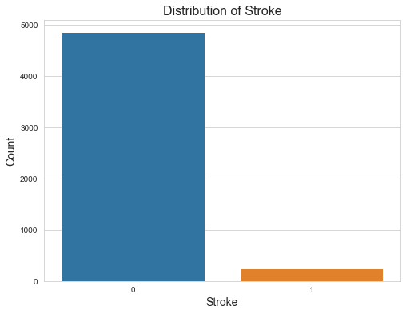
Analysis with Bar plot
From this distribution we got to know
Less people have brain stroke.

Slide 6
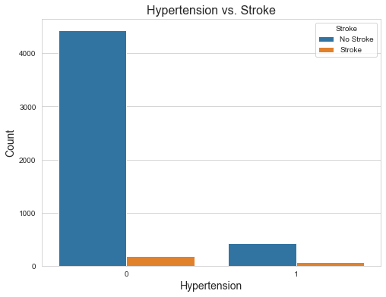
Count Plot for hypertension Vs Brain stroke
From this graph it is visible that who is suffering from hypertension they have less chances of getting brain stroke.
And who doesn’t have hypertension they have small amount of chances that they will get brain stroke.

Slide 7
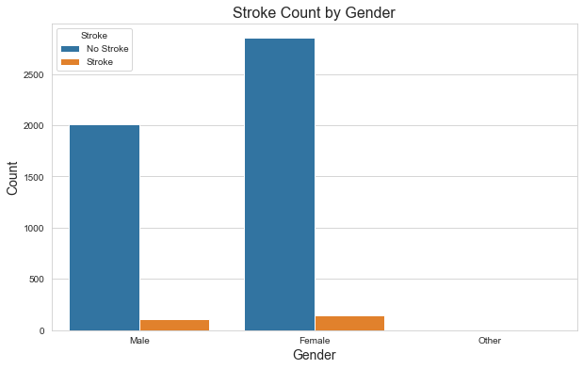
Analysis with Count plot
From this count plot we could see that ‘Male’ and ‘Female’ both have almost same ratio for having brain stroke but it is also seen that most of the ‘Female’ not suffering from stroke compared to ‘Male’.

Slide 8
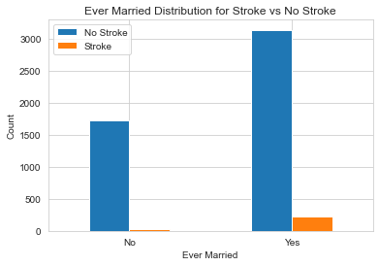
Count plot for ever Married
From the visualization it is clearly visible married people have chances of having brain stroke.

Slide 9
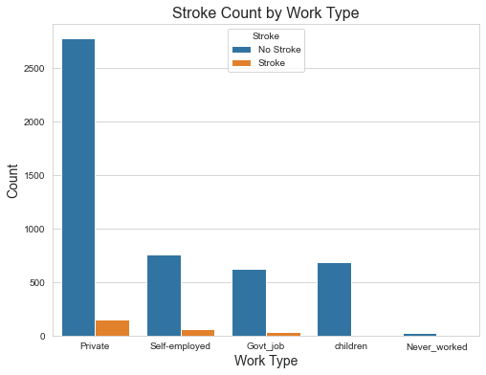
Count plot for Worktype and stroke
In this graph we can tell who have private job they have higher rate of brain stroke, meanwhile who are children and never worked they don’t have brain stroke.

Slide 10
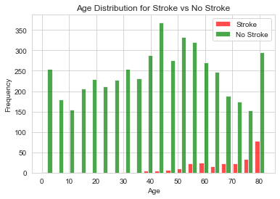
Histogram for age and stroke
Histogram clearly visualized that from age between 50-80 have highest count for having brain stroke.

Slide 11
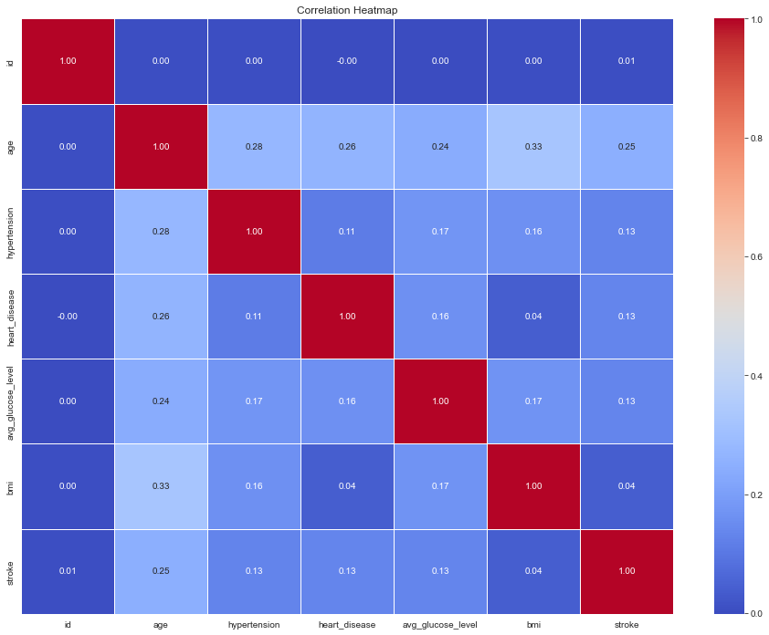
Heatmap
It explain the relationship between all the attributes.
‘bmi’ attribute doesn’t have relationship for brain stroke.
Whereas ‘age’ attribute have somewhat relation with stroke.

Slide 12
Model Building process
Train the dataset with selected machine learning models. The models learn to map the input features to the target variable (stroke or no-stroke) based on the patterns in the training data.
Handling missing value: We will find and remove missing values.
LabelEncoding : We will convert categorical data into numerical data so that our machine learning algorithms process the data effectively.
Splitting of the data : using train_test_split , split the dataset in 80:20 / 85:15/ 70:30 format and we will train the model to check the accuracy.
StandardScaler: It's applied to ensure that the features have similar scales, which can be beneficial for many machine learning algorithms.
Model Selection: As our dependent variable is categorical, we will use all classification algorithms such as Logistic Regression, Support Vector Machine, K-Nearest Neighbors, decision trees and Random Forest Algorithm.
Model Training: Train the model using above algorithms, including hyperparameter tuning, cross-validation, and any other relevant training strategies.
Check Model Performance: Calculate for accuracy, bias and variance to check for how our model is performing.

Slide 13
Results with algorithms
Algorithm | Accuracy | Bias | Variance
Logistic | 0.9471624266144814 | 0.9522994129158513 | 0.9471624266144814
SVM | 0.9461839530332681 | 0.9527886497064579 | 0.9461839530332681
KNN | 0.9461839530332681 | 0.9530332681017613 | 0.9461839530332681
Decision Tree | 0.9412915851272016 | 0.9525440313111546 | 0.9412915851272016
Random Forest Classifier | 0.9471624266144814 | 0.9522994129158513 | 0.9471624266144814

Slide 14
Conclusion
After using hyperparameter tuning in machine learning algorithm we got the accuracy as 94%, bias as 95% and variance as 94% for each and every machine learning (classification) algorithm. It indicates that the model is performing well.

Slide 15
THANK YOU!

